Slide 1

SEGMENT ANYTHING
A. Kirillov et al., 2023 (Meta AI Research)
Daniele Napolitano, daniele.napolitano4@studio.unibo.it
Master’s Degree in Artificial Intelligence, University of Bologna

Slide 2
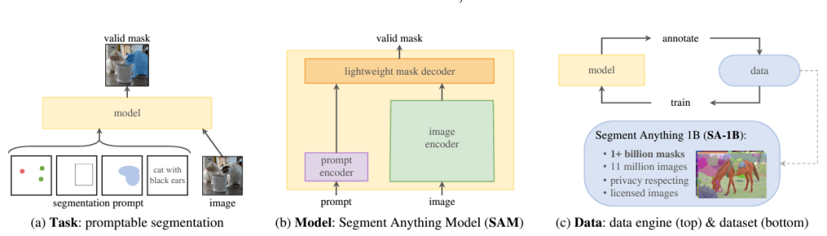
Three main introductions

Slide 3
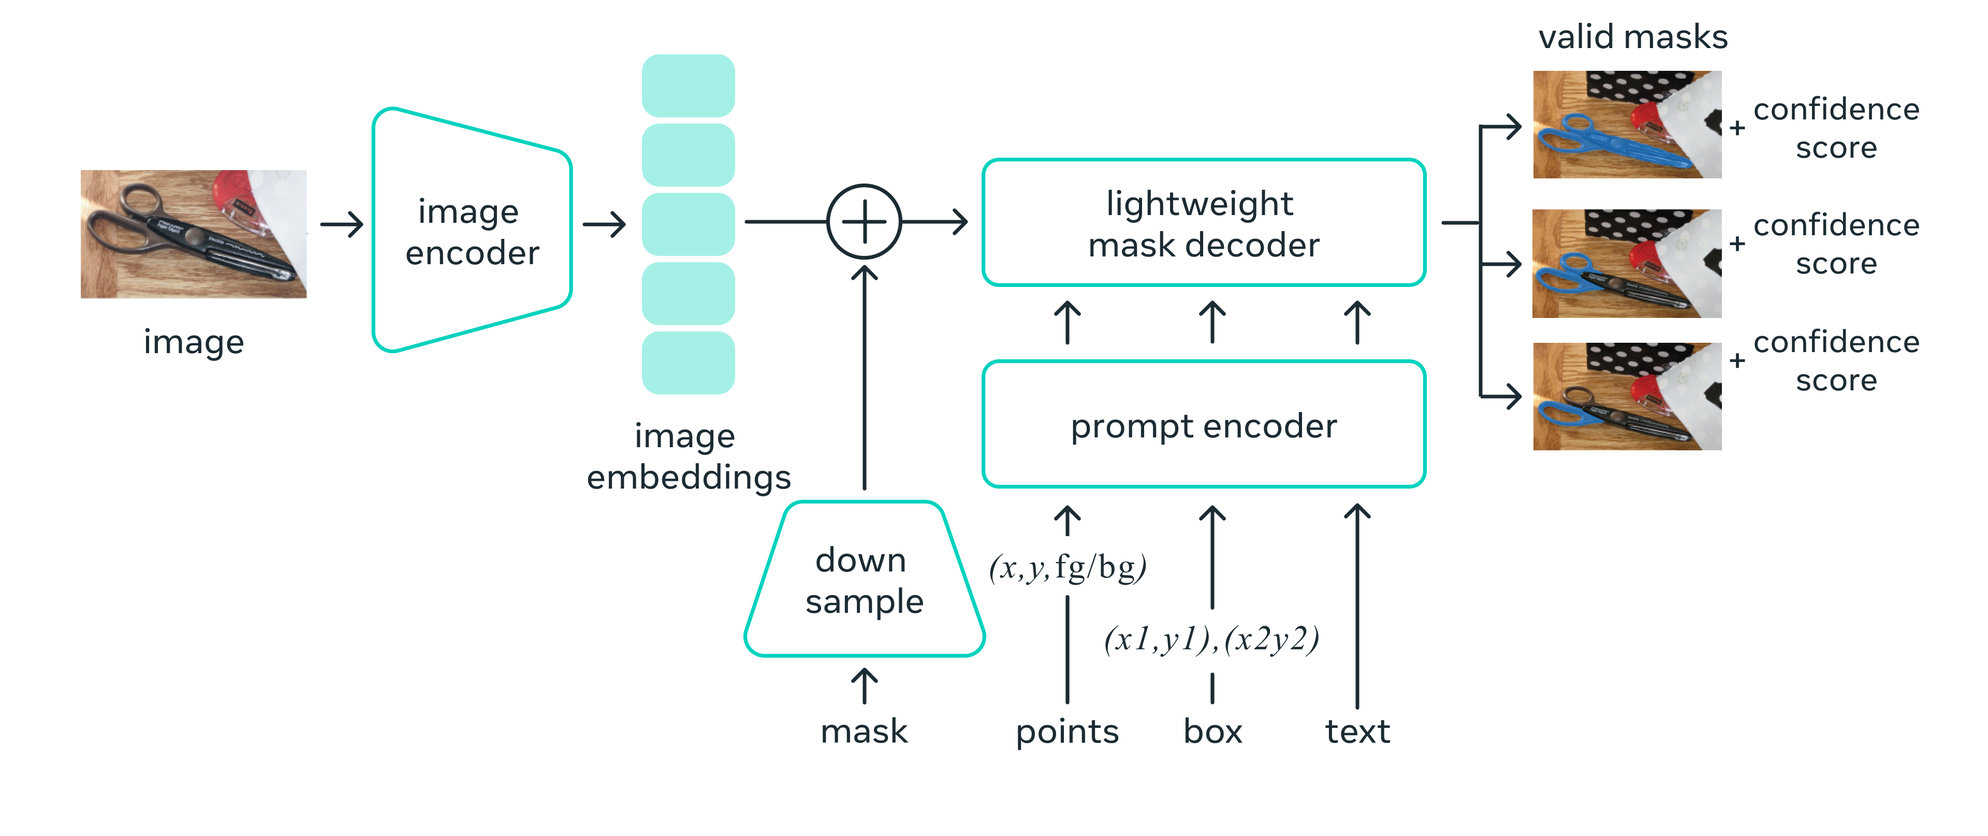


Segment Anything Model (SAM)
ViT
+
MAE
pre-training
Outputs three masks for disambiguation
+
Confidence scores
CNN
Positional embedding
CLIP

Slide 4
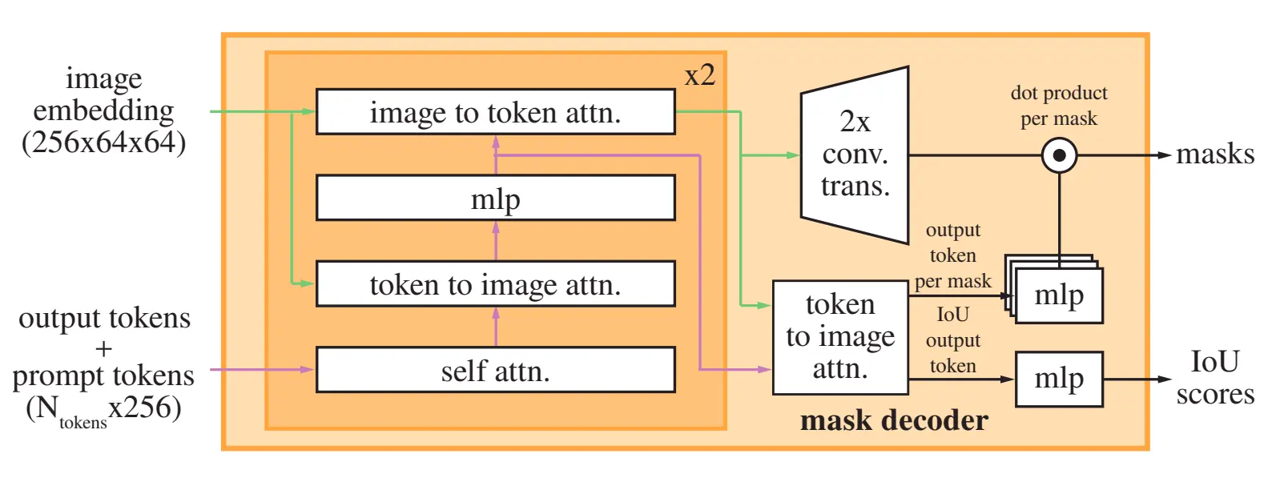
Mask decoder
Inspired by Transformer Segmentation models
Similar structure of a Transformer Decoder
Has a Mask head and a IoU head (confidence score)

Slide 5
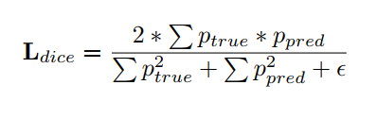
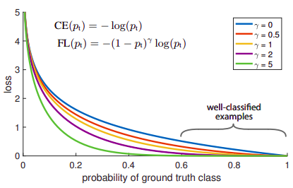
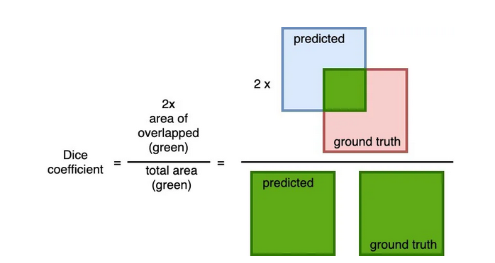
Loss and training
IoU head: MSE
Mask head: linear combination (20:1) of:
Focal loss
Dice loss
(Note: only the mask with lowest loss gets propagated during training)

Slide 6
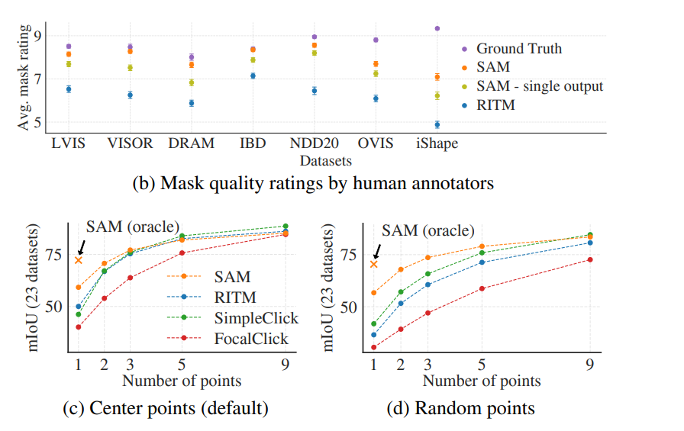
Loss, training and evaluation
Loss
Evaluation
IoU head: MSE
Mask head: linear combination of Focal and Dice loss
Training recipee
Optimizer: AdamW
LR schedule:
linear warmup for 250 epochs
step-wise decay

Slide 7
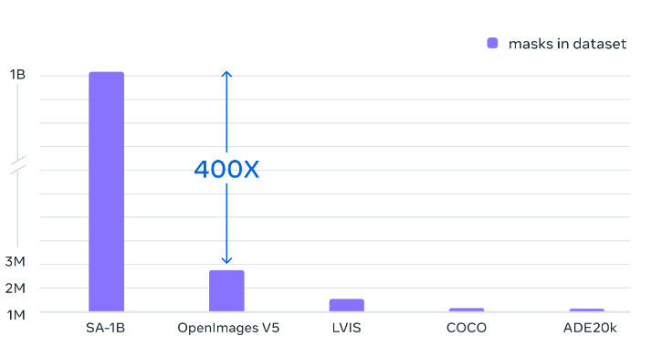
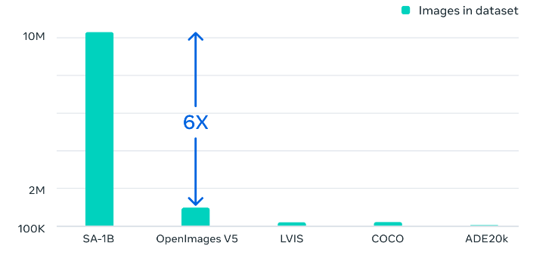
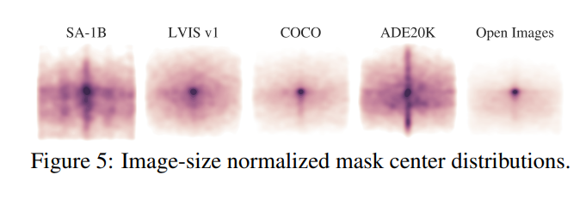
SA-1B Dataset and data engine
Built by keeping the model in the loop
Trained iteratively: as it improves, the gathering process becomes increasingly automated
Diverse and well distributed dataset

Slide 8
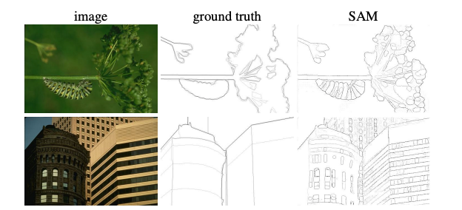
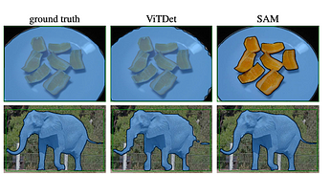
Zero-Shot Transfer experiments
Zero-Shot edge detection
Zero-Shot instance segmentation
Prompt SAM with a regular grid of points
Irrelevant masks are removed with NMS
Edges extracted from masks with Sobel detector
Run an object detector first,
Prompt SAM with its output boxes

Slide 9
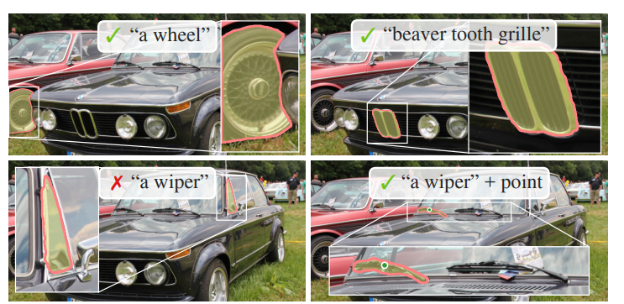
Zero-Shot Transfer experiments
Zero-Shot edge detection
Zero-Shot Text-to-Mask
Prompt SAM with a regular grid of points
Irrelevant masks are removed with NMS
Edges extracted from masks with Sobel detector
Modified verion of SAM (trained with CLIP’s image embeddings)
Providing additional point prompts can help

Slide 10
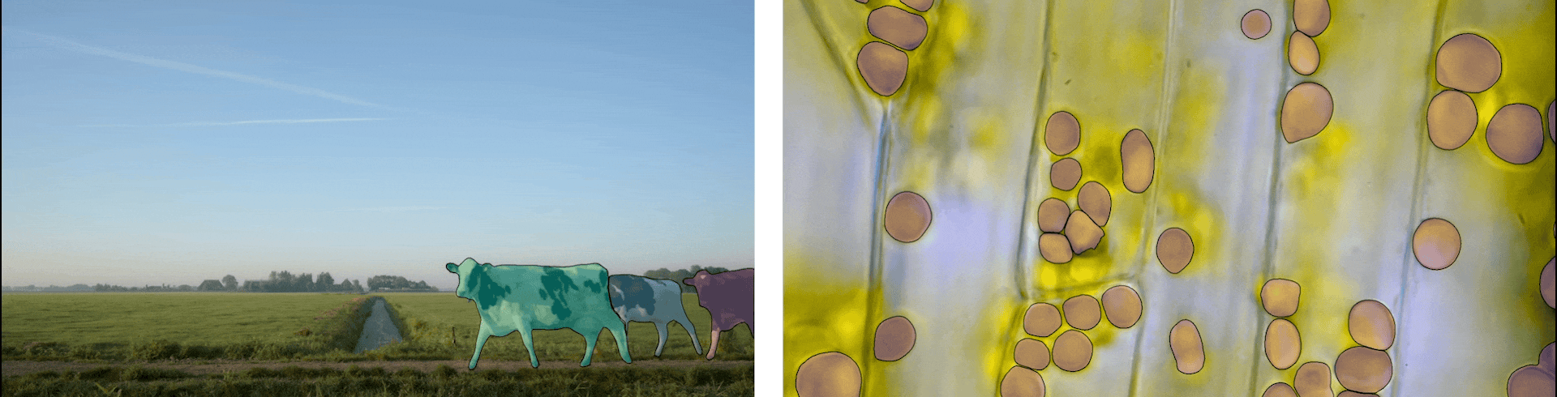
Conclusions
First step towards foundation models for image segmentation.
Through fine-tuning, it can be adapted to perform downstream tasks
Potential of being applied to multiple applications in a wide range of domains

Slide 11
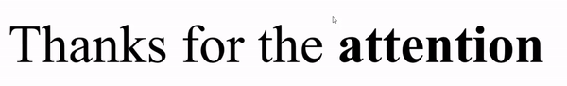
Daniele Napolitano
daniele.napolitano4@studio.unibo.it
Machine Learning for Computer Vision
Master’s Degree in Artificial Intelligence, University of Bologna

